Slide 1
CS2040 Lab#05 B03 (Please set up your camera for Visualgo quiz) 28/9/2020

Slide 2
Palindrome
Lab4 Recursion Q1

Slide 3
Introduction
You are given a string of n <= 20 characters. Determine if you can turn the string into a palindrome by deleting at most k <= 6 characters.
A string is a palindrome iff s[i] == s[n-i-1] for all i<n
Strategy: start from the outermost letters. If they match, move inwards. Otherwise, remove either the one at the left or the right. If you don’t run out of deletions, you’ll meet in the center.
Use recursive function which returns a boolean

Slide 4
Solution
Time complexity: O(2^k + n)
//left records the position of left char we are checking, right similarly defined.
boolean recurse(int left, int right, int deletions_remaining) {
if (left >= right) {
//reached the middle
return true;
}
if (s[left] == s[right] {
return recurse(left+1, right-1, deletions_remaining);
} else if (deletions_remaining > 0) {
// go left or go right
return recurse(left+1, right, deletions_remaining-1) or recurse(left, right-1, deletions_remaining-1)
}
return false;
}
boolean canFormPalindrome = recurse(0, s.length()-1, k);

Slide 5
CS2040 LAB04 Qns2 Movies

Slide 6
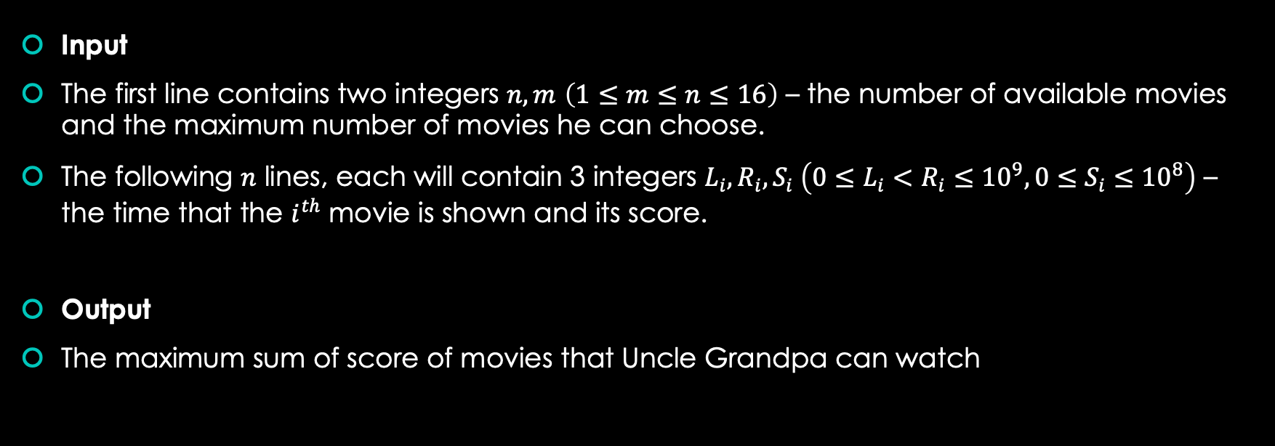
Briefing about the question

Slide 7
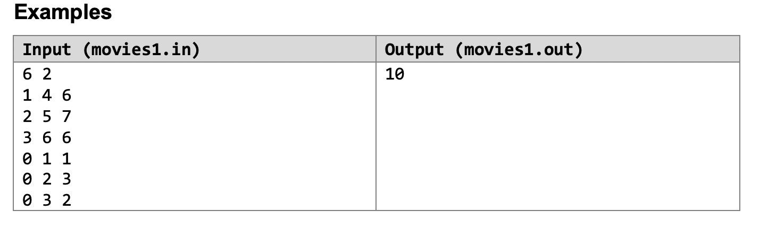
Briefing about the question
Explanation:
In this example, one of the possible way is to choose the 2nd movie (starts at 2, ends at 5 and has a score of 7) and the 5th movie(starts at 0, ends at 2 and has a score of 3).

Slide 8
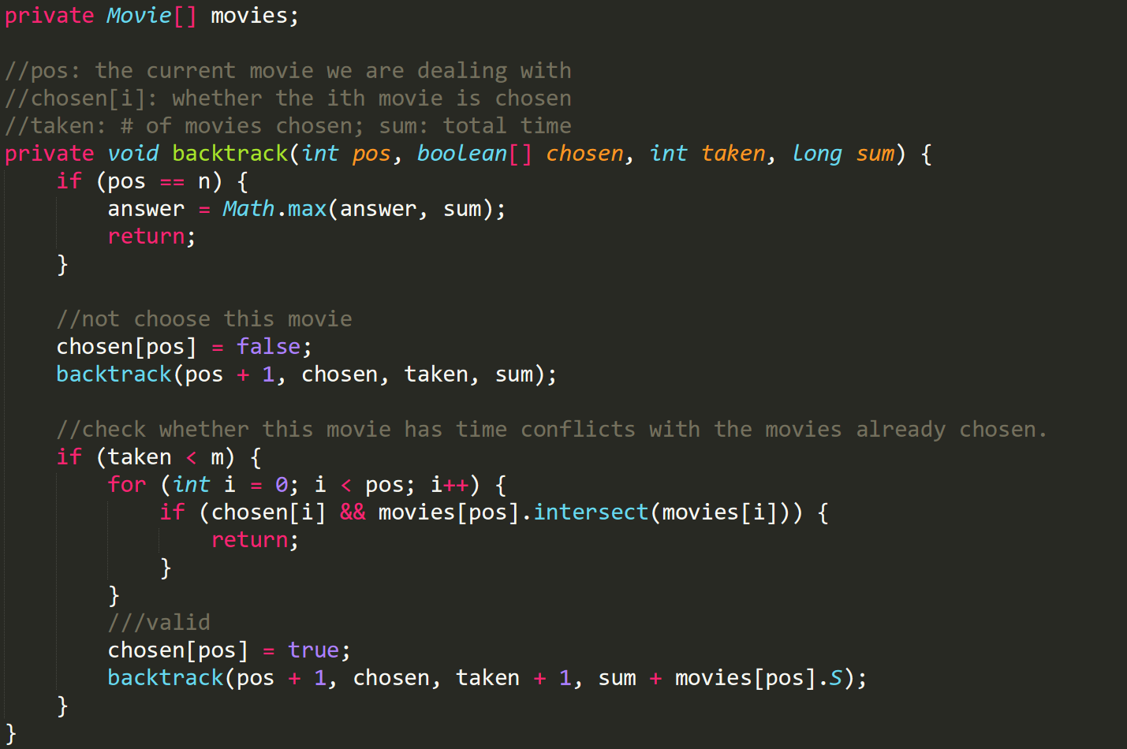
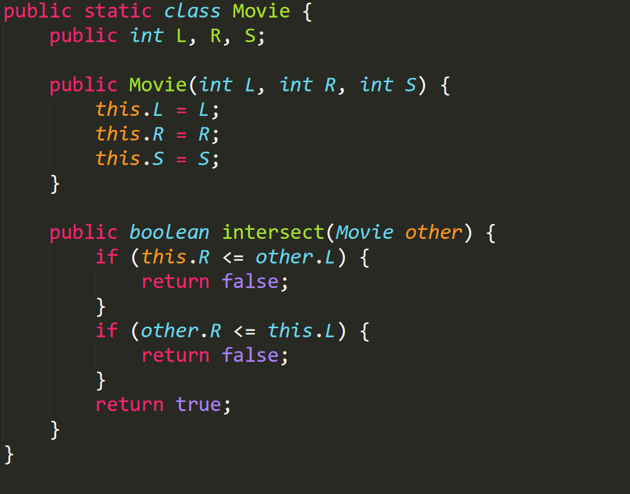
Solution

Slide 9
Visualgo quiz

Slide 10
Visualgo quiz
10 questions in 10 minutes
Make sure you record the right screen
Upload your recording to TG group after the quiz,
and name your video as NAME+MATRIC NUMBER+ SCORE
https://visualgo.net/training?diff=hard&n=10&tl=10&module=recursion

Slide 11
Inversion
Lab 5 Problem 1

Slide 12
Summary
Given an array of ints, find the minimum number of swaps between adjacent elements to sort the array.

Slide 13

Wait…
Swaps between adjacent elements???
Final output is a sorted array???

Slide 14
Sounds like Bubble Sort!

Slide 15
Approach 1
Perform bubble sort on the input array
Sum the number of swaps along the way

Slide 16
Complexity
Time complexity: O(n^2)
Space complexity: O(1) (in-place)

Slide 17
Zero
Lab 5 Problem 2

Slide 18
Understand the Problem
Uncle Grandpa has an array. He wants to count the number of subarray (a continuous nonempty segment of the array) that has the sum equal to zero.
Hint: use cumulative sum

Slide 19
Understand the Problem
Limits:
Elements ≤ 2.1bil – Can fit within int
Number of elements ≤ 10⁵
Ans may overflow int
≤ (10⁵ + 1)C2

Slide 20
Ideas
If number k appears n times in cum sum of an array, it means there are (n choose 2) subarrays whose sum is 0.
Sum from index i+1 to index j = cumsum[j] –cumsum[i]
E.g. : cum sum 1 6 3 8 6 4 6
We just need to count the frequency of numbers in cumsum and calculate.
Note that 0s in cumsum needs to be treated differently.

Slide 21
Noname
Lab 5 Problem 3 (Demo)

Slide 22
Summary
Given an array a with n element
Find number of unordered pair (i, j) such that i < j and a[i] + a[j] <= T
1 <= n <= 10⁵
0 <= a[i], T <= 10⁷

Slide 23
Idea
Define cnt[i] as the amount of number with value i
Then define prefix[i] as the amount of number with value less than or equal to i.
Easily calculate: prefix[i] = prefix[i – 1] + cnt[i] and prefix[0] = cnt[0]

Slide 24
Idea
First, we calculate answer for ordered pair (i, j) that i != j, then divide answer by 2 for final result.
For each 0 <= i <= T, we will account to the answer
prefix[T – i] as i + j <= T for j <= T – i
If T – i >= i, decrease the answer by cnt[i] (we don’t want to count pairs of form (x, x) (same index))

Slide 25
Example run
T = 8, A = [3, 1, 5, 7]
cnt = [0, 1, 0, 1, 0, 1, 0, 1, 0, …]
prefix = [0, 1, 1, 2, 2, 3, 3, 4, 4, …]
Set answer = 0
i = 1, answer += cnt[1] * prefix[7] – cnt[1] -> answer = 3
i = 3, answer += cnt[3] * prefix[5] – cnt[3] -> answer = 5
i = 5, answer += cnt[5] * prefix[3] -> answer = 7
i = 7, answer += cnt[7] * prefix[1] -> answer = 8
Divide answer by 2, we get the result 4.

Slide 26
Second solution

Slide 27
Idea
Sorting does not affect the result
Ex:
T = 8, A = [3, 1, 5, 7]. Result is 4
T = 8, A = [1, 3, 5, 7]. Result is 4

Slide 28
Idea
Assuming a is a monotonically non-decreasing sequence, e.g
a[1] <= a[2] <= …. <= a[n]
For any x, y, if y > 1 and a[x] + a[y] <= T then a[x] + a[y – 1] <= T
Therefore, for every x, find maximum y such that a[x] + a[y] <= T. (if y does not exist, then y = 0)
Then we can add min(y, x – 1) to the answer (avoid double counting)

Slide 29
Idea
Suppose we have found maximum y for x such that a[x] + a[y] <= T.
Define z as maximum number that a[x + 1] + a[z] <= T. Then z <= y
Proof:
If y = n, trivial.
Otherwise, a[x] + a[y + 1] > T. If z > y, then a[x + 1] + a[z] >= a[x + 1] + a[y + 1] >= a[x] + a[y + 1] > T (contradiction)

Slide 30
Idea
Set y = n, iterate x from 1 to n
In each iteration, decrease y until y = 0 or a[x] + a[y] <= T. Add min(y, x – 1) to the answer

